Slide 1


Socrative Link:
https://api.socrative.com/rc/5fvfh7

Slide 2

Assignment questions
When you are asked to express a quantity in terms of another quantity, we are looking for an algebraic expression.
When you are asked to calculate a value, we are looking for a numerical solution.
When you are asked to sketch an electric or magnetic field, then we are looking for a labelled drawing of the field vectors.
When you are asked to explain your choice/assumptions/reasoning or comment on an aspect of the calculation you should do this in your own words demonstrating your understanding of the situation.
The marks can provide a rough guide as to the level of detail expected in the answer or number of steps.
Dr. Charlotte Palmer/Prof. Gianluca Sarri
Notes:
https://api.socrative.com/rc/5fvfh7

Slide 3
PHY2084: Electromagnetism and Optics
Lecture 13:
Electromagnetic waves
and energy transport
Dr. Charlotte Palmer/Prof. Gianluca Sarri

Slide 4
Wave equation: recap
For a perfect dielectric (zero conductivity) then the wave equation reduces to:
with a phase velocity given by:
The phase velocity of the wave in a medium, c’, is less than the phase velocity in the vacuum, c, for all the materials that we’ll encounter here and the ratio of these speeds gives us the material’s refractive index which is always greater than 1.
Note: we defined the wave-vector, k, using the wavelength but we can also express it as:
We also know that our waves are transverse waves in which the electric and magnetic field vectors are always orthogonal to the direction of propagation which is defined by the wave-vector, k.
Dr. Charlotte Palmer/Prof. Gianluca Sarri
Notes:
https://api.socrative.com/rc/5fvfh7

Slide 5
Socrative 1:
We’re going to try to relate the amplitudes of our sinusoidal electric and magnetic fields in the EM wave. We’ll use one of Faraday’s laws to start. Which one?
Gauss’ law for electric fields
Gauss’ law for magnetic fields
Faraday’s law of induction
Ampere’s law
Don’t know
Dr. Charlotte Palmer/Prof. Gianluca Sarri
Notes:
https://api.socrative.com/rc/5fvfh7

Slide 6
Relation between E and H
But what do we know about the relative amplitude of the electric and magnetic fields?
To explore this further it’s very useful to use the complex form for the solution to the wave equation.
Complex form: Remember the fields we experience are the real part of these expressions.
We know that these are related to one another via the Maxwell-Faraday law so we can use the law to try to express E₀ in terms of H₀:
Remember:
Substituting into Faraday’s law, we have:
Dr. Charlotte Palmer/Prof. Gianluca Sarri
Following derivation from John Edwards - https://www.youtube.com/watch?v=86eU7TKTr5U
Consider a plane wave:
For this, Faraday law can be written as:
Rearranging:
Notes:
Because free space has capacitance (permittivity) and inductance (permeability). Those are intrinsic properties of space. Capacitance and inductance when excited by time varying source (like EM wave) they behave as if they were resistors (impedance). The only difference is that those resistors do not dissipate power as a real resistor does. That is why a plane wave is not attenuated while it is traveling In free space.
https://physics.stackexchange.com/questions/79364/why-does-vacuum-have-a-nonzero-characteristic-impedance-towards-electromagnetic

Slide 7
Relation between E and H
This expression can be simplified and rearranged to give us E₀ in terms of H₀ or vice versa:
Earlier we saw that wavenumber, k, can also be expressed in terms of angular frequency of the light and the material properties so this expression becomes:
Units: V/m
Units: A/m
Units: V/A = impedance
Dimensional analysis shows us that this value is equivalent to an impedance.
Dr. Charlotte Palmer/Prof. Gianluca Sarri
Following derivation from John Edwards - https://www.youtube.com/watch?v=86eU7TKTr5U
Consider a plane wave:
For this, Faraday law can be written as:
Rearranging:

Slide 8
Vacuum impedance
If we consider the vacuum,
The vacuum has an effective impedance that is a real number, since μ₀ and ε₀ are real and positive. Vacuum impedance is often give the symbol Z₀ or 𝜂
All dielectrics will have an associated impedance that, in the region
of visible frequencies (μ_{r} ~ 1) is given by:
Z₀
Note: 𝜀 and 𝜇 can also be complex numbers, describing both the amplitude and phase of the electric and magnetic components of the electromagnetic wave.
Dr. Charlotte Palmer/Prof. Gianluca Sarri

Slide 9
Relationship between E and B
We can follow exactly the same logic to determine the relationship between E and B.
Try it now
Dr. Charlotte Palmer/Prof. Gianluca Sarri

Slide 10
Relationship between E and B
We can follow exactly the same logic to determine the relationship between E and B.
Try it now
You should have found that now we can express the two terms as:
We’re back at the phase velocity of light again!
Dr. Charlotte Palmer/Prof. Gianluca Sarri

Slide 11
Socrative 2:
In a vacuum, what has the smaller amplitude, E or B?
Electric field
Magnetic field
Don’t know
Dr. Charlotte Palmer/Prof. Gianluca Sarri
Notes:
https://api.socrative.com/rc/5fvfh7

Slide 12
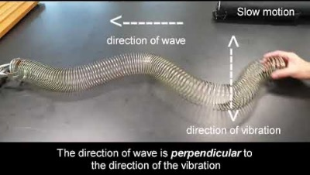
Energy transport
From interactions with transverse waves, we know that they can transport energy through a medium without moving matter.
From Youtube: Transverse wave using a slinky
But light doesn’t have to propagate in a medium, and yet we know from our daily interactions with light that energy can be transported by electromagnetic waves.
From the quantum model of light we know how much energy is associated with each photon but how can we determine the energy transported by a continuous wave of light by electric and magnetic fields that aren’t even pointing the right way.
Dr. Charlotte Palmer/Prof. Gianluca Sarri

Slide 13
Energy stored in fields
We know from our work with circuits that energy can be stored in electric and magnetic fields using capacitors and inductors.
Energy of electric field in a simple capacitor:
Energy of electric field in a simple inductor:
Often it’s more useful to have a value for energy density as then we can determine how that would scale for different systems.
For electric fields in a parallel plate capacitor we can convert our energy stored to an energy density of electric field using Gauss’ law.
Dr. Charlotte Palmer/Prof. Gianluca Sarri

Slide 14
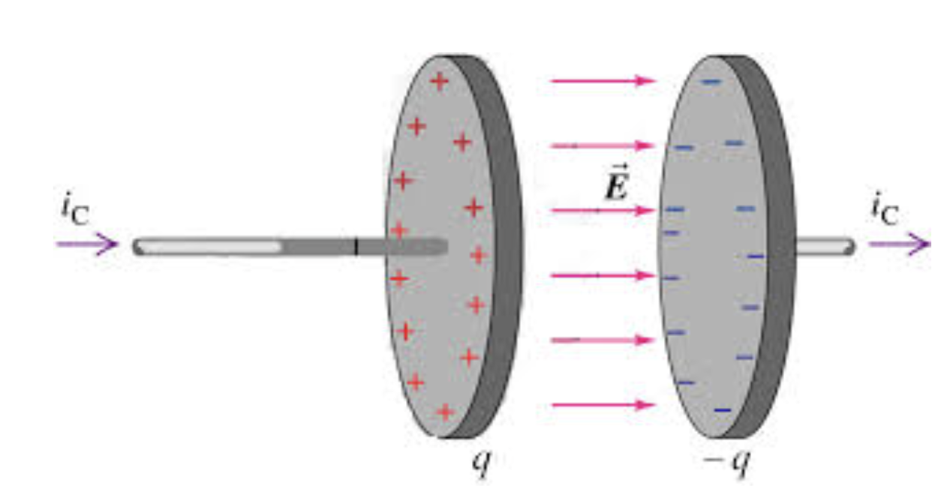
Energy stored in fields
From Dr. C. L. Davis, Uni. Louisville
Substituting these into the expression for energy stored in the capacitor field:
Volume occupied by the field
Energy density of electric field in a vacuum capacitor is therefore:
Dr. Charlotte Palmer/Prof. Gianluca Sarri

Slide 15
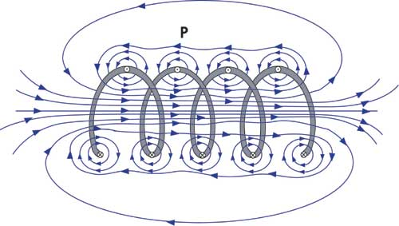
Energy stored in fields
For magnetic fields in an inductor we can start from Ampere’s law to link current and magnetic field:
From Iowa State University
Then Faraday’s law to find an expression for inductance:
Volume occupied by the field
Substitute into expression for energy of magnetic field in a solenoid:
Energy density of magnetic field in a solenoid:
Dr. Charlotte Palmer/Prof. Gianluca Sarri

Slide 16
Energy stored in fields
Energy density of magnetic field in a vacuum solenoid:
Energy density of electric field in a vacuum capacitor:
We can use the relationship between E and B to express either of these in terms of the other for an electromagnetic wave in vacuum.
Energy density of an electromagnetic wave
Dr. Charlotte Palmer/Prof. Gianluca Sarri

Slide 17
Energy transport
Often we talk about the energy arriving at or leaving a surface in a given time.
This box contains energy with a constant density. Therefore we know that the total energy in the box is:
Energy density x A x ct
Power per unit area, S : aka…
Irradiance
Radient flux
Emissive power
Energy flux
Energy flux density
A
ct
Power per unit area of an electromagnetic wave
Magnitude of the Poynting vector for an EM wave in vacuum.
A formal derivation of the Poynting vector can be obtained from Maxwell’s equations.
But first: What direction do you think the Poynting vector of our vacuum will point?
Dr. Charlotte Palmer/Prof. Gianluca Sarri

Slide 18
Socrative 3:
What direction will the Poynting vector/Energy flow point for our propagating plane wave?
In the same direction as the electric field
In the same direction as the magnetic field
Between the electric and magnetic field
In the direction the wave is propagating
Don’t know
Dr. Charlotte Palmer/Prof. Gianluca Sarri
Notes:
https://api.socrative.com/rc/5fvfh7

Slide 19
Poynting’s theorem and the Poynting vector
Poynting’s theorem relates to the conservation of energy within electric and magnetic fields and uses the Poynting vector, S, to represent energy flow.
“The stored energy in a given volume changes at a rate given by the work done on the charges within the volume minus the rate at which energy leaves the volume”
Current density (movement of charge)
Rate at which fields do work on charges in the volume
OR density of electric power dissipated by Lorentz force doing work on charge carriers.
Rate of change of energy density
Divergence of Poynting vector.
(divergence indicates sources/sinks of energy)
Dr. Charlotte Palmer/Prof. Gianluca Sarri

Slide 20
Poynting’s theorem and the Poynting vector
This can also be expressed as:
Rate of change of energy density
Divergence of Poynting vector.
(divergence indicates sources/sinks of energy)
Density of electric power dissipated by Lorentz force doing work on charge carriers.
Density of reactive power driving the build-up of electric field in vacuum
Density of reactive power driving the build-up of magnetic field in vacuum
If we look back to Maxwell’s equations we can derive a similar expression which provides some insight into the magnitude of the Poynting vector, S.
Dr. Charlotte Palmer/Prof. Gianluca Sarri

Slide 21
Socrative 3:
Which of Maxwell’s equations must we include in this derivation?
Gauss’ law for electric fields
Gauss’ law for magnetic fields
Faraday’s law of induction
Ampere’s law
Don’t know
Dr. Charlotte Palmer/Prof. Gianluca Sarri
Notes:
https://api.socrative.com/rc/5fvfh7

Slide 22
Socrative Link:
https://api.socrative.com/rc/5fvfh7

Slide 23
Poynting’s theorem and the Poynting vector
This can also be expressed as:
Rate of change of energy density
Divergence of Poynting vector.
(divergence indicates sources/sinks of energy)
Density of electric power dissipated by Lorentz force doing work on charge carriers.
Density of reactive power driving the build-up of electric field in vacuum
Density of reactive power driving the build-up of magnetic field in vacuum
If we look back to Maxwell’s equations we can derive a similar expression which provides some insight into the magnitude of the Poynting vector, S.
Dr. Charlotte Palmer/Prof. Gianluca Sarri

Slide 24
Poynting vector derivation
Starting from the macroscopic Maxwell-Ampere law and the Maxwell-Faraday law:
And we take the scalar product of the first with E and second with H:
Chain rule:
and:
This leads to:
Dr. Charlotte Palmer/Prof. Gianluca Sarri

Slide 25
Poynting vector derivation
We then subtract the two equations from each other:
We can then use a vectorial identity to simplify the left-hand side:
Poynting’s theorem in vacuum
Poynting vector:
Vector describing energy density and direction of energy flow.
Units of S: [V/m][A/m] = W/m²
Dr. Charlotte Palmer/Prof. Gianluca Sarri

Slide 26
Significance of Poynting’s theorem
By rearranging Poynting’s theorem we can see clearly the balance of energy in electric and magnetic fields and energy added or lost from the system due to sources/sinks/work on charges.
Rate of change of power density in electric and magnetic fields in vacuum
Density of electric power dissipated by Lorentz force – Ohmic heating.
Energy density of sources or sinks
Integrating this over a volume we convert our energy densities to actual energy.
The energy loss is then associated with a SURFACE component (corresponding to the energy been radiated away from the region) plus a VOLUMETRIC component (corresponding to the possible presence of currents in the material).
In this sense the Poynting vector can be physically interpreted as the instantaneous energy being "radiated" across unit area of the surface.
Dr. Charlotte Palmer/Prof. Gianluca Sarri

Slide 27
Socrative 1:
What mathematical tool was used to turn the volume integral of the Poynting vector divergence into a surface integral?
Kelvin-Stokes’ theorem
Gauss’ theorem
Vector identity
Don’t know
Dr. Charlotte Palmer/Prof. Gianluca Sarri
Notes:
https://api.socrative.com/rc/5fvfh7

Slide 28
Electric and magnetic energy density
The Poynting vector describes total flow of energy:
We can use Poynting’s theorem and the Poynting vector to determine the energy transported by electromagnetic waves.
Let’s use our simple plane wave:
The energy flows in the positive z direction which is the same direction as the wave.
Dr. Charlotte Palmer/Prof. Gianluca Sarri

Slide 29
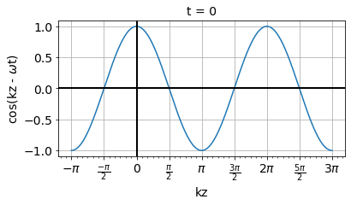
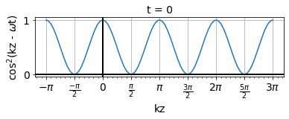
Instantaneous energy flow
The magnitude of our electric field varies between positive and negative with time (the direction of the electric field flips).
The magnitude of the Poynting vector varies with time at twice the frequency of the electromagnetic field but is always positive with a maximum amplitude equivalent to E₀H₀ as we saw before.
If the Poynting vector was negative, this would imply the wave was traveling in the opposite direction.
Dr. Charlotte Palmer/Prof. Gianluca Sarri

Slide 30
Electric and magnetic energy density
Let’s see how this compared with our energy density of electric and magnetic fields determined earlier.
In absence of bound charges …
Energy density of magnetic:
Energy density of electric field:
We can also express this as:
Now we have a more general expression. Let’s check that this gives us the same result as the cross product.
Dr. Charlotte Palmer/Prof. Gianluca Sarri

Slide 31
Electric and magnetic energy density
Combining the energy stored in the separate fields to find the total energy in the EM wave:
Dr. Charlotte Palmer/Prof. Gianluca Sarri
Notes:
WHAT DOES IT MEAN THAT IT INCLUDES E AND D – WHY IS THIS FORM USEFUL?

Slide 32
Electric and magnetic energy density
So now we have an expression for energy density, we can calculate the energy arriving at a surface.
A
ct
Now we can see how the cross product of the electric and magnetic field strength provide us with a vector describing the energy delivered to a surface – the Poynting vector.
Dr. Charlotte Palmer/Prof. Gianluca Sarri

Slide 33
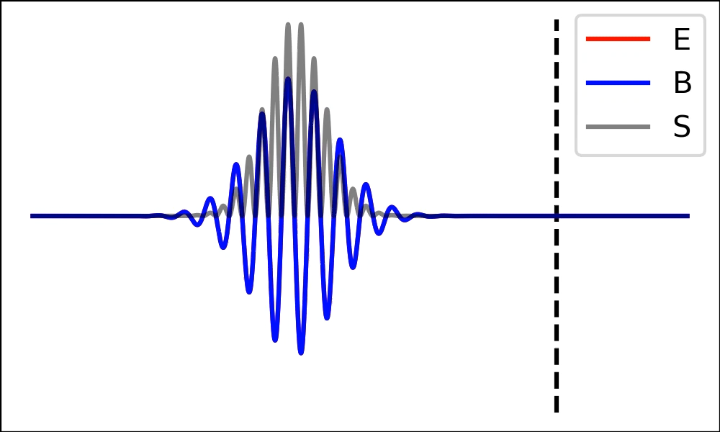
Instantaneous energy flow
Here we can see the Poynting vector of an electromagnetic pulse reflecting from a perfect mirror.
From M. Streeter (QUB)
As we’ve seen before the magnitude of the Poynting vector is oscillating at twice the frequency of our electromagnetic wave.
Usually we’re more interested in the time-average power delivered, which would increase towards the centre of this pulse and then decrease again.
Dr. Charlotte Palmer/Prof. Gianluca Sarri

Slide 34
Socrative 2:
We want to find the time-averaged Poynting vector. What mathematical tool might we use to find the time average?
Taking magnitude of the Poynting vector and dividing by the wavelength.
Differentiating the Poynting vector with respect to time
Integrating the Poynting vector over one oscillation
Don’t know
Dr. Charlotte Palmer/Prof. Gianluca Sarri
Notes:
https://api.socrative.com/rc/5fvfh7

Slide 35
Time-averaged energy flow
To find the time-averaged power, we typically integrate the power delivered over a single oscillation period of the fields and divide it by the period.
Integral of Poynting vector over one period gives us the energy in one cycle of the fields, divided by the cycle duration gives average power
Time-averaged Poynting vector
Using our expression for Poynting vector:
Dr. Charlotte Palmer/Prof. Gianluca Sarri

Slide 36
Time-averaged energy flow
Remember:
Note:
Time-averaged Poynting vector
Pfew we made it! If only there was an easier way …
Dr. Charlotte Palmer/Prof. Gianluca Sarri

Slide 37
Time-averaged energy flow using complex notation
We can also use the complex form to describe an electromagnetic wave.
BUT it’s important to remember that only the real component of this gives us our measurable fields, the complex notation is a mathematical trick to help us out so let’s test it.
To calculate the Poynting vector we would take the real part of the wave as before:
But if we calculate the complex Poynting vector we can jump straight to the time-averaged solution.
Dr. Charlotte Palmer/Prof. Gianluca Sarri

Slide 38
Time-averaged energy flow using complex notation
Complex Poynting vector:
Directly gives us the time-averaged power flow
Dr. Charlotte Palmer/Prof. Gianluca Sarri
The factor of half is included at the start to ensure that the

Slide 39
Socrative 3:
What is isotropy?
When a molecule has one chemical formula but different arrangements of atoms?
When a material has the same number of electrons and protons but different numbers of neutrons?
When material properties are the same in all directions except the direction of wave propagation?
When material properties are the same in all directions?
Don’t know
Dr. Charlotte Palmer/Prof. Gianluca Sarri
Notes:
https://api.socrative.com/rc/5fvfh7

Slide 40
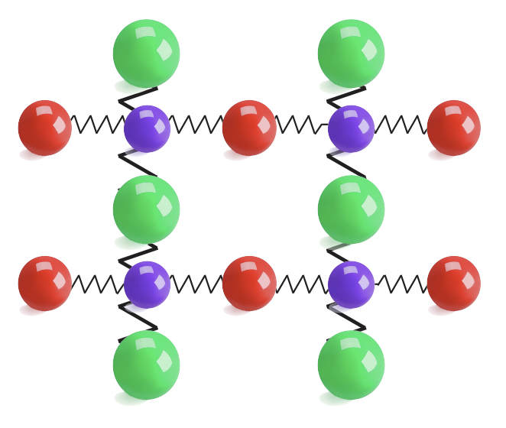
Anisotropic media
We now have two expressions for the energy stored in a magnetic field.
Note: These rely on E being a linear function of D (no nonlinear optics). Beyond the scope of the course.
So far we have only considered isotropic materials where E and D are parallel but this is not always the case.
Anisotropic media are media in which the properties depend on the direction and these can lead to non-parallel electric field and displacement field through a directional dependence of the permittivity.
Anisotropy leads to fun behaviour with the speed of light varying with polarization of the electric field – e.g. birefringence, waveplates …
From San Jose State University: Peter Beyersdorf
Dr. Charlotte Palmer/Prof. Gianluca Sarri

